Slide 1
MIS 321
Web Project

Slide 2
Let’s Create a Basic Web Project
Create a project folder
Inside the project folder. Create 2 sub projects.
API
This folder will store the code for our back in processing.
Client
This folder will store our front end code (html, css, javascript, etc.)

Slide 3
Let’s Create a Basic Web Project
Install code generator package
This only has to be done one time on your machine
dotnet tool install -g dotnet-aspnet-codegenerator
Create a new Web API Project
This is similar to how we create a new console app, just for APIs
dotnet new webapi

Slide 4
Let’s Create a Basic Web Project
Install CodeGeneration.Design package to local project
This must be done for each web project you build
Within the API directory run the following command
dotnet add package Microsoft.VisualStudio.Web.CodeGeneration.Design
Generate a controller for our project
dotnet aspnet-codegenerator controller -name <ControllerName> -async -api --readWriteActions -outDir Controllers
Substitute books for <ControllerName>

Slide 5
Let’s Create a Basic Web Project
Test the API
dotnet watch run
Go to the url…. i.e. https://localhost:5001/api/books

Slide 6
Let’s Add Some Functionality
In the API folder, create a subfolder called Models
Inside of Models, create a class called Book
Add properties for Id (integer), Title (string), and Author (string)
Add a ToString method to display the ID + “ “ + Title + “ written by “ + Author
Create ReadBookData Class
Class should implement a GetBook interface and a GetAllBooks interface
Don’t forget to install the SQLite package
dotnet add package System.Data.SQLite.Core

Slide 7
Let’s Add Some Functionality
Update the Books Controller to get all books from the database
Update the Get() method to call the GetAllBooks() method.
Update the return type of the method to List<Book>
Instantiate an IGetAllBooks object
Return the call to the GetAllBooks method
Update the Books Controller to Get 1 book from the database
Test by hitting the urls

Slide 8
Let’s Update our CORS Policy
Update your Program.cs file by adding in the emboldened portion.
using Microsoft.AspNetCore.Cors;
var builder = WebApplication.CreateBuilder(args);
builder.Services.AddControllers();
builder.Services.AddCors(options =>
{
options.AddPolicy(”OpenPolicy",
builder =>
{
builder.AllowAnyOrigin()
.AllowAnyMethod()
.AllowAnyHeader();
});
});

Slide 9
Let’s Update our CORS Policy
Add the emboldened portion to the bottom of your Program.cs file.
app.UseHttpsRedirection();
app.UseAuthorization();
app.UseCors(”OpenPolicy");
app.MapControllers();
app.Run();
Dotnet 6.0 -> Enable Cross-Origin Requests (CORS) in ASP.NET Core | Microsoft Docs

Slide 10
Let’s Add The Front End
In the Client folder create an index.html file
Start typing HTML in the file and choose the boilerplate starter code for an HTML5 document
Create a div in the body and set the id to books
Create a javascript file
Create a resources folder in the Client folder
Create a scripts folder in the resources folder
Create a index.js file in the scripts folder
Link the javascript file in the body of the html file

Slide 11
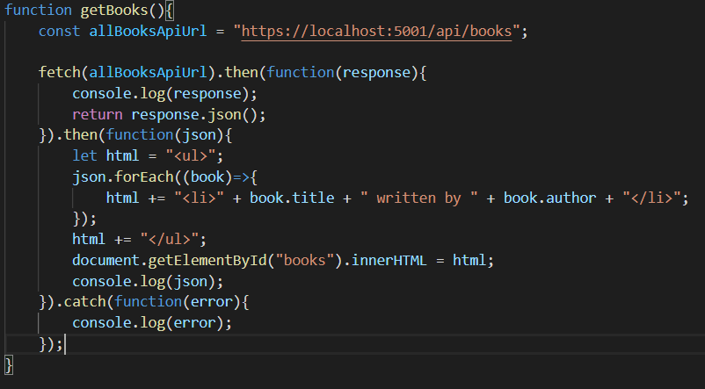
Make the API Call
Create a javascript function called getBooks
Create a const holding your URL
Make a fetch call to get the response data
Call the json method on response and return the resulting json array
Use the json array to update the <div> with your books

Slide 12
Time To Add A Book
Create a new IInsertBook interface
1 method called InsertBook that takes a book as its only parm
Create a new SaveBook class that implements the IInsertBook interface
Should use the passed in book to insert data into the database
Update the Books Controller
Add Cors policy
Instantiate a IInsertBook object
Call the InsertBook method

Slide 13
Time To Add A Book
Add a form to index.html to accept a new book
Add text input for title and author
Add a label for each
Add a submit button
Update form onsubmit to return false and set the method to post
Update the onclick method of the submit button to be postBook()

Slide 14
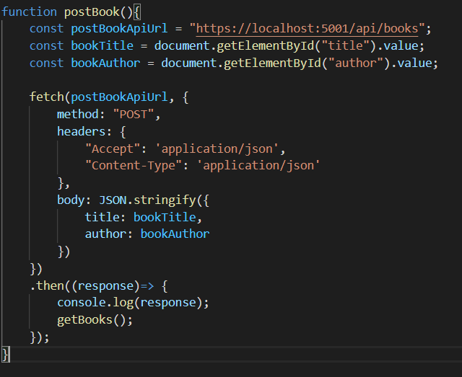
Time To Add A Book
Add the postBook method to your javascript

